Slide 1
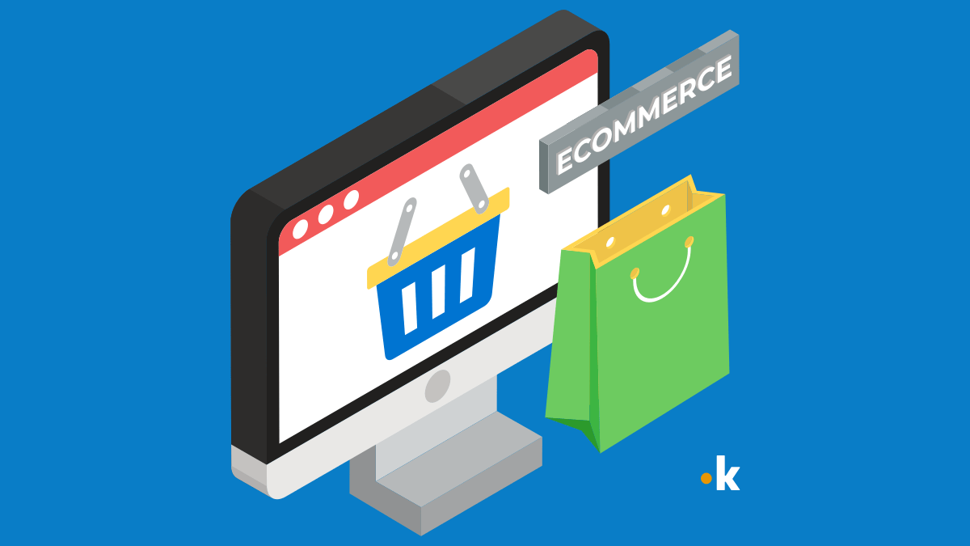
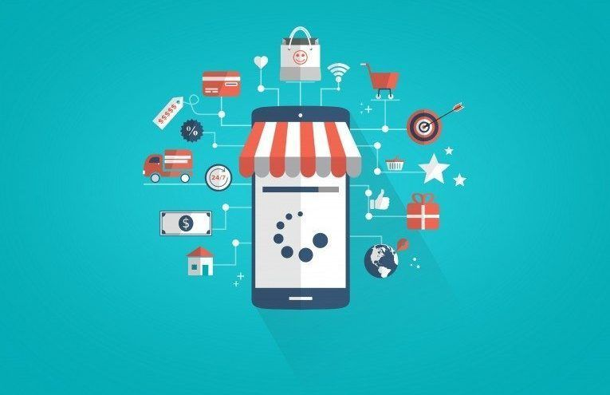
E-commerce application on ibm cloud foundry
Thrisha K
This Photo by Unknown Author is licensed under CC BY-NC

Slide 2

Phase 1 project
Problem Definition
Design Thinking
​
​

Slide 3

Problem definition
This project is to build an artisanal e-commerce platform using IBM cloud foundry . The goal is to connect skilled artisanal with a global audience showcasing their handmade products and providing features like secure shopping carts payment gateways and an intuitive checkout process. This involves designing the ecommerce platform, implementing necessary features , and ensuring a seamless user experience. Ensure that the application is intuitive and easy to use, with a user-friendly interface that facilitates product search, selection, and purchase. Ensure the application is highly available and reliable, minimizing downtime and disruptions to customers.

Slide 4
Design thinking
Design your thought

Slide 5
Design thinking
Platform
design
Product
showcase
User authentication
Shopping cart and checkout
Payment integration
USER EXPERIENCE

Slide 6
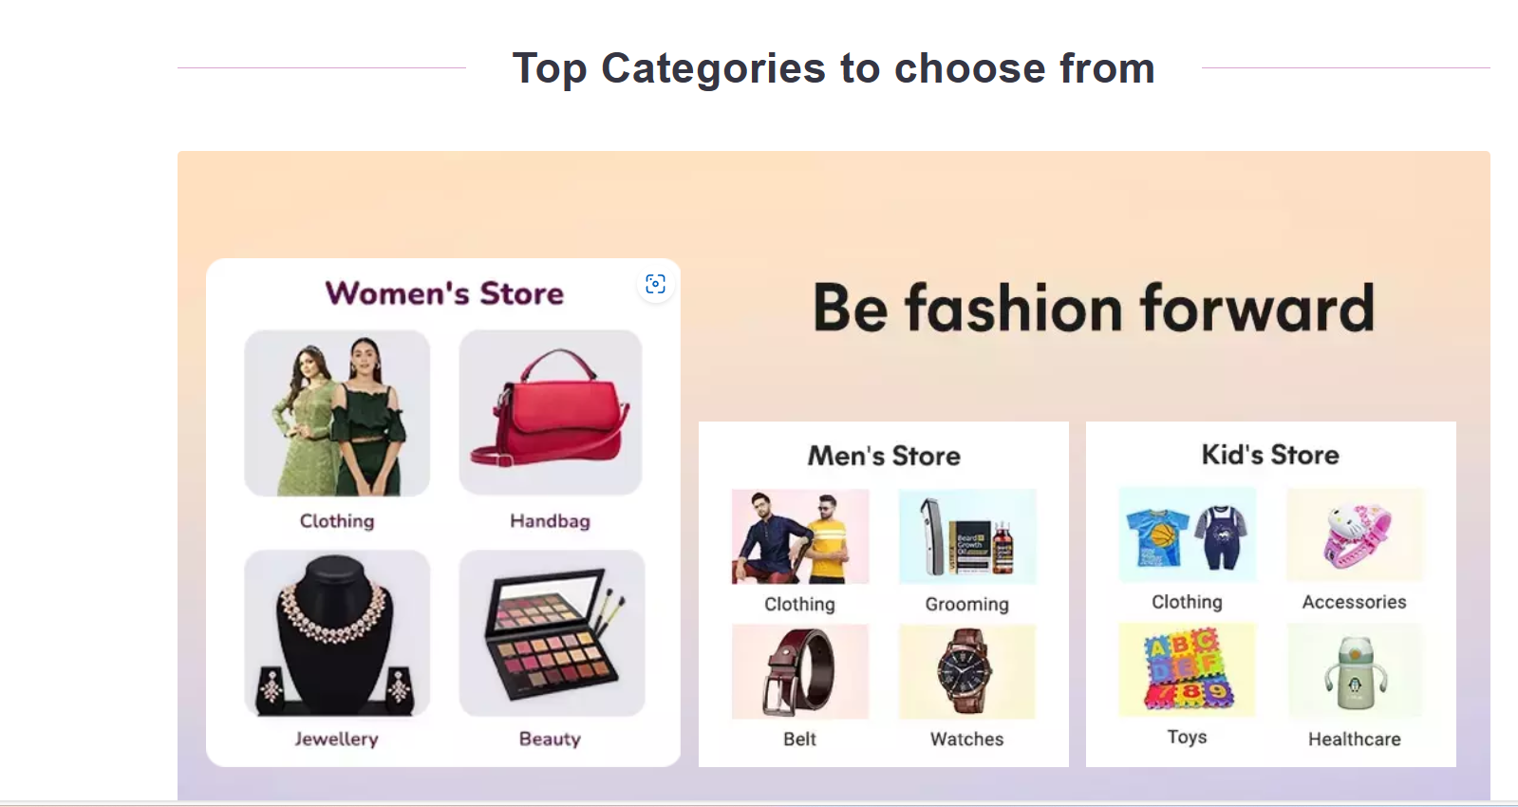
Platform design:
Design the platform layout with sections for product categories, individual product pages , shopping cart , checkout and payment.
Product Categories:
Below the header, create a section for product categories. This section should display images and text links to different product categories.
Each category image should be a clickable link leading to a category page.

Slide 7
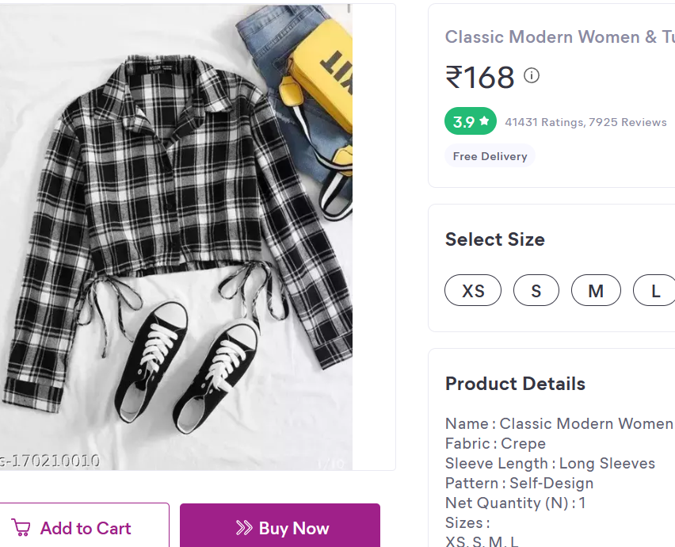
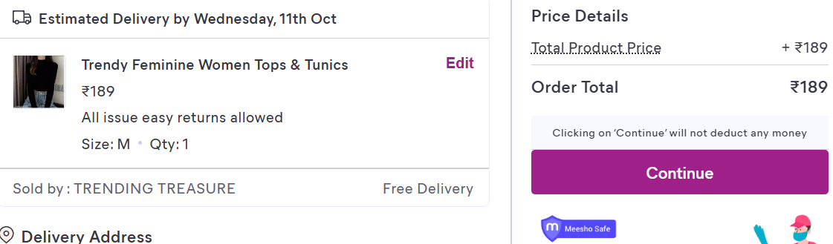
Individual product pages :
Each product should have an image, product name, price, and an "Add to Cart" button
Shopping cart and checkout payment:
After adding items to the cart, users can proceed to checkout.
On the checkout page, provide various payment options such as credit/debit card, PayPal, or other payment gateways.

Slide 8
Product showcase:
Create a database to store product information such as images, descriptions, prices and categories.
Creating tables : Products Table:
Attributes:ProductID (Primary Key, Auto-incremented),ProductName (String),Description (Text),Price (Decimal),CategoryID (Foreign Key),ImageURL (String)
Categories Table:
Attributes:CategoryID (Primary Key, Auto-incremented),CategoryName (String)
Use Cases From Backend
Product Listing: Retrieve a list of products with their names, prices, and images for displaying on the website.
Sql query: SELECT ProductName, Price, ImageURL FROM Products;
Category Filtering: Allow users to filter products by category by querying the "Products" table based on the CategoryID field.
Sql query: SELECT ProductName, Price, ImageURL
FROM Products
WHERE CategoryID = category_id;

Slide 9
Product Details: Display the detailed product description and price when a user selects a specific product.
Sql query: SELECT ProductName, Description, Price, ImageURL FROM Products WHERE ProductID = product_id;
Adding New Products: Insert new products into the "Products" table, specifying the product's name, description, price, category, and image URL.
Sql query:INSERT INTO Products (ProductName, Description, Price, CategoryID, ImageURL)
VALUES ('New Product Name', 'Product Description', 19.99, 1, 'image_url.jpg');
Updating Product Information: Modify product details such as price, description, or image URL when necessary.
Sql query:UPDATE Products
SET Price = 24.99, Description = 'Updated Description'
WHERE ProductID = product_id;
Deleting Products: Remove products from the database when they are no longer available.
Sql query:DELETE FROM Products WHERE ProductID = product_id;

Slide 10
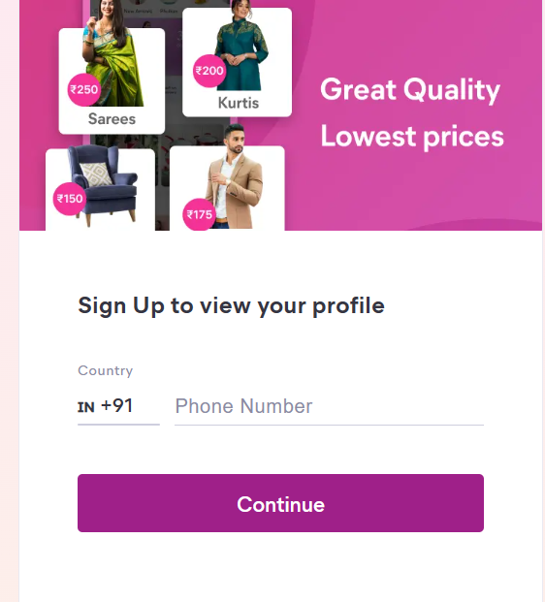
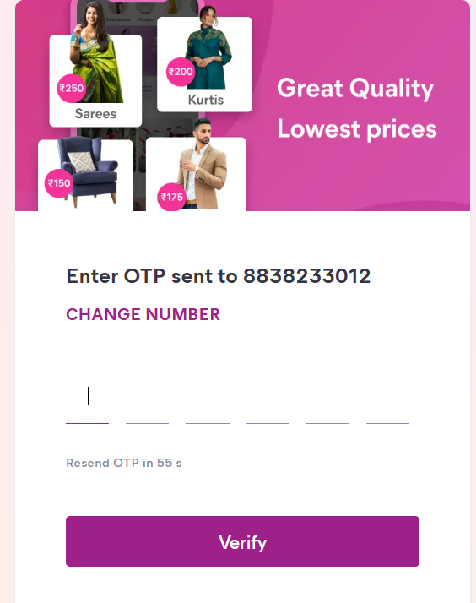
User authentication:
Implement user registration and authentication features to enable artisans and customers to access the platform

Slide 11
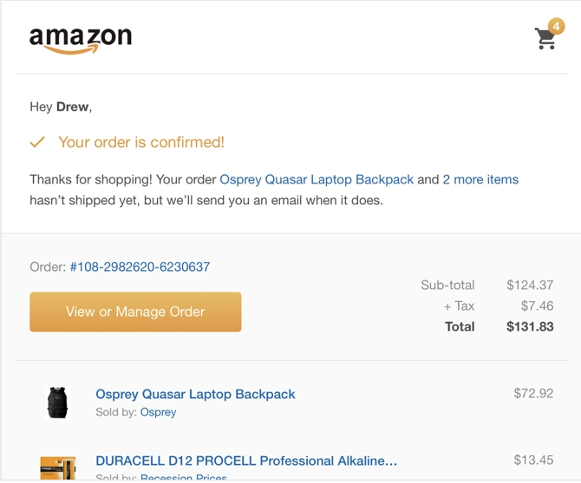
Shopping cart and checkout:
Design and develop the shopping cart functionality and a smooth checkout process.
Shopping Cart Functionality:Include a shopping cart icon or link in the website's header to give users easy access to their cart.
Smooth Checkout Process:Create a multi-step checkout process, with each step clearly labeled
Order Confirmation:Display a confirmation message and order number to users after successfully placing an order.
Error Handling and Validation:Implement robust error handling to gracefully manage issues such as payment failures, invalid addresses, or out-of-stock items.
Testing:Thoroughly test the entire checkout process with real and simulated transactions to identify and resolve any issues.

Slide 12
Payment integration:
Integrate secure payment gateways to facilitate transactions
1. Choose a Payment Gateway:
Research and choose a reputable payment gateway provider that suits your business needs. Popular options include Stripe, PayPal, Square, and Authorize.Net.
Front-End Integration:
Create a user interface for customers to input payment information.
Design and implement a payment form that collects credit card details, billing address, and any other required information.
Back-End Integration:
Implement server-side code to handle payment processing.
Use the payment gateway's server-side SDK or API to make secure API requests for authorization and capture of funds.
Verify and validate payment details on the server to prevent fraudulent transactions.

Slide 13
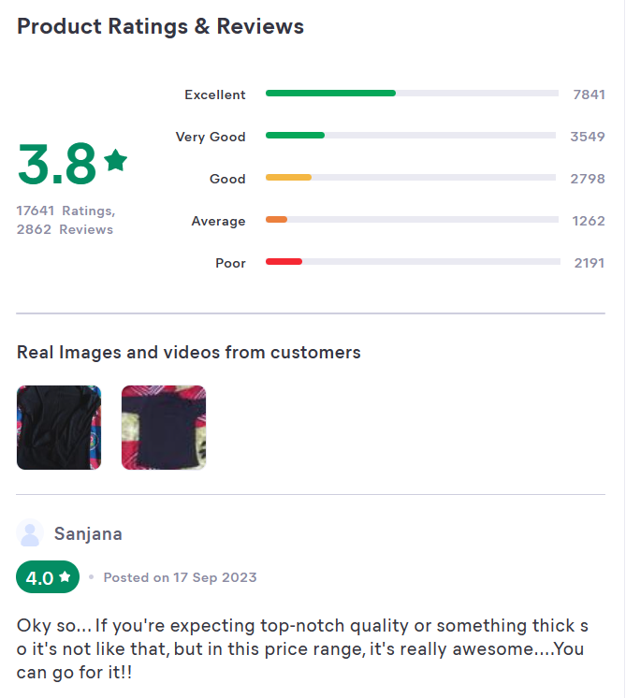

User experiance:
Focus on providing an intuitive and visually appealing user experience for both artisan
Reviews and Ratings:Allow users to leave feedback and ratings for products they've purchased.
Wishlist and Favorites: - Enable users to create wishlists and save their favorite products for future reference.
Social Sharing: - Integrate social sharing buttons to encourage users to share their favorite products on social media.
Support and Assistance: - Offer customer support through chat, email, or phone for any inquiries or issues.

Slide 14
THANK YOU
THRISHA K
thrishuthrisha@gmail.com

